Slide 1
LECTURE 13:
STORYTELLING
April 20, 2021
R. Jordan Crouser Smith College

Slide 2
Final project
Goal: apply the visualization techniques we’ve learned to a real-world dataset you care about
You may work in groups (recommended) or on your own
Deliverables:
an interactive visual analytics system demonstrated
by video as part of our end-of-semester miniseries, associated documentation, and a brief write up of the methods you used
Example problems

Slide 3


open dataset
yelp.com/dataset

Slide 4
open dataset: example ?s
Cultural Trends: What makes a particular city different? For example, in which countries are Yelpers sticklers for service?
Location Mining: How much of a business' success is really just location, location, location? Do reviewers' behaviors change when they travel?
Seasonal Trends: What about seasonal effects: are there more reviews for sports bars on major game days?
Infer Categories: Do you see any non-intuitive correlations between business categories e.g., how many karaoke bars also offer Korean food, and vice versa?
Social Graph Mining: Can you figure out who the trend-setters are? For example, who found the best waffle joint before waffles were cool?

Slide 5
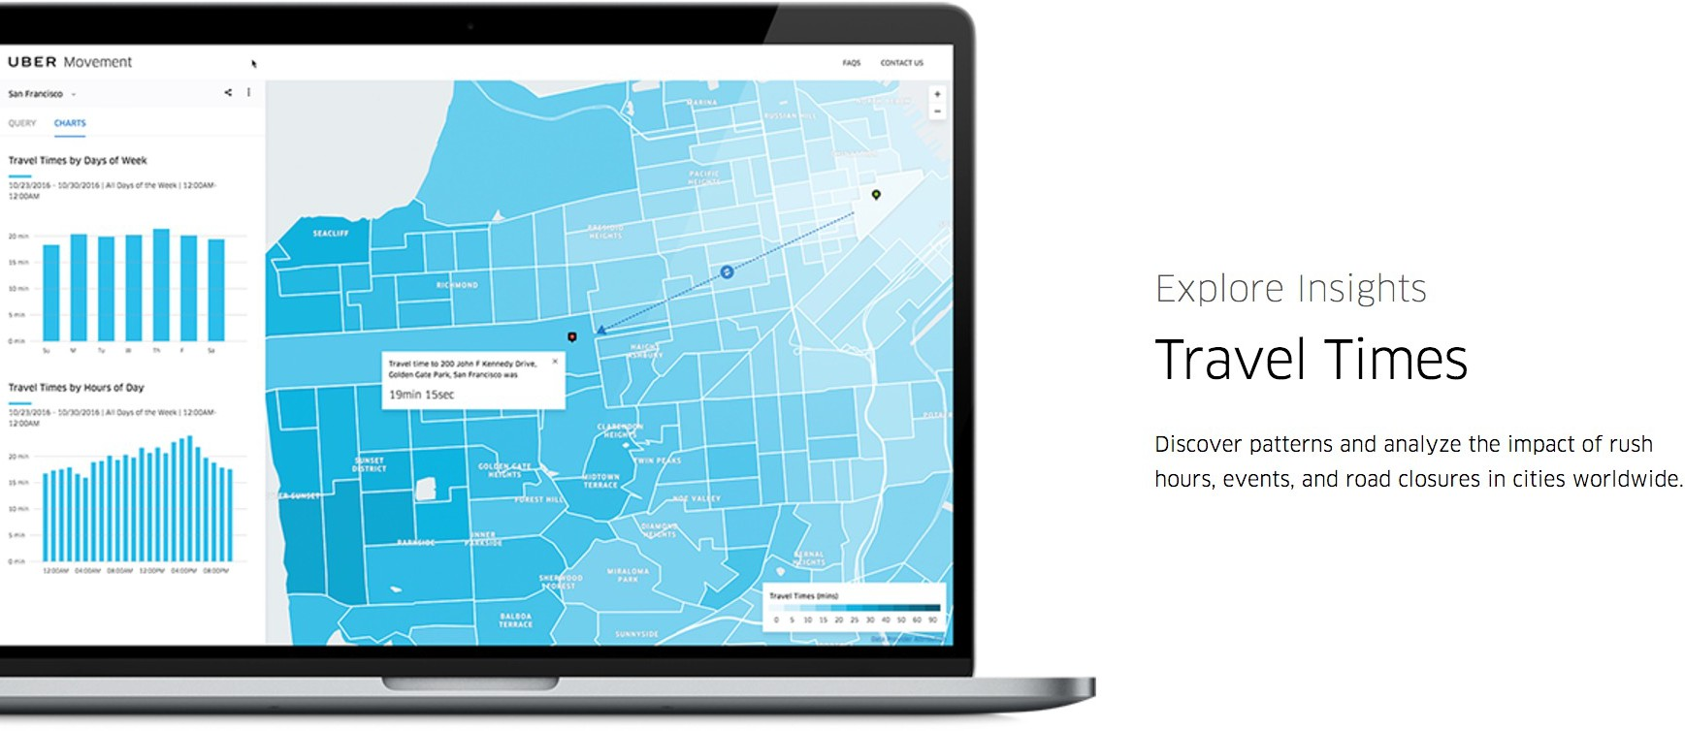
movement.uber.com

Slide 6
: example ?s
Impact on other modes of transportation: What happens to taxi, bus, subway, etc. usage when Uber enters the market?
Spatial analysis: Are there any interesting geographic trends? How do these relate to demographics?
Event detection: Can you see ripple effects of sporting events, concerts, etc. in Uber data?

Slide 7
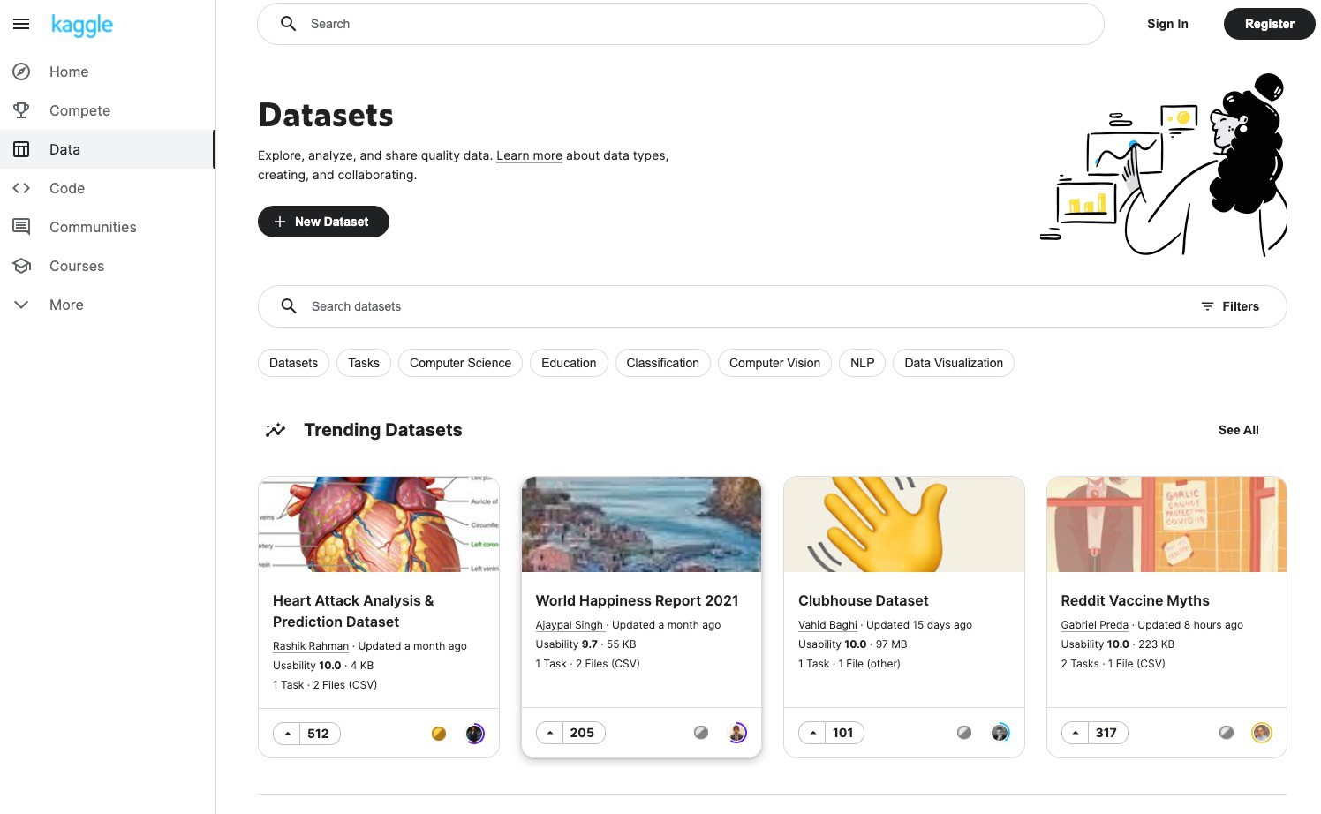
kaggle.com

Slide 8
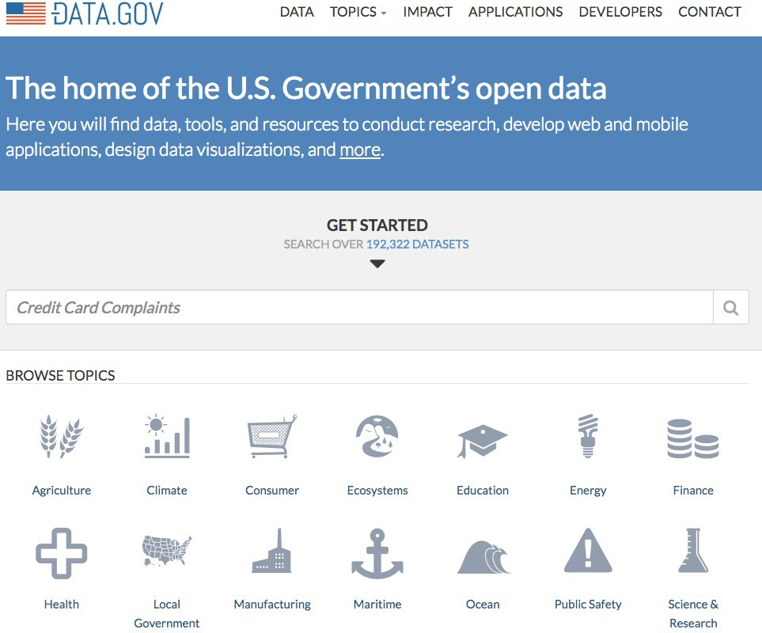
data.gov

Slide 9

Data about Smith
Want data?
Start here.
www.smith.edu/about-smith/institutional-research

Slide 10
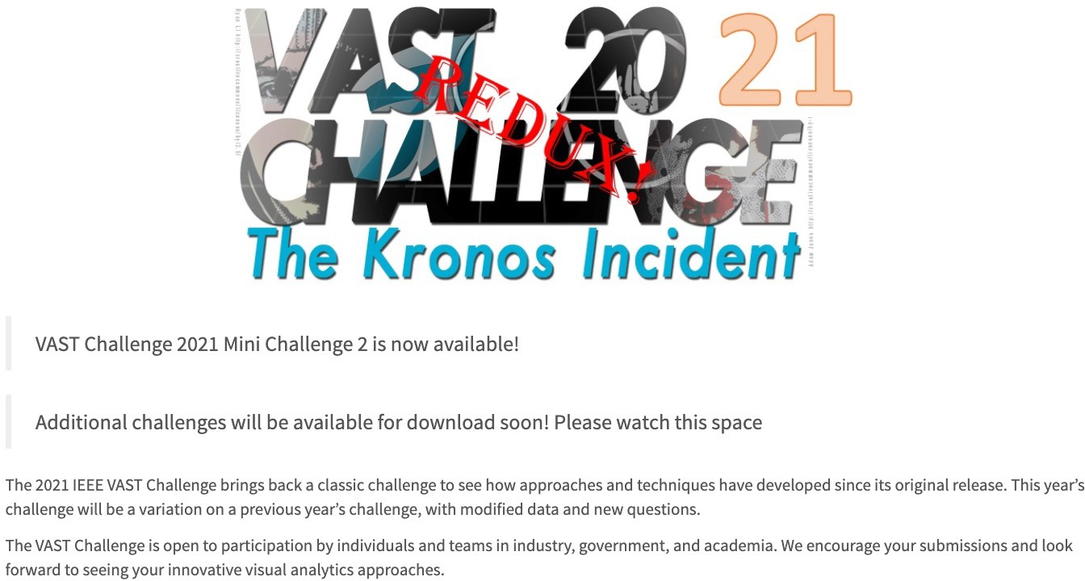
Want something like the DCs?
vast-challenge.github.io/2021

Slide 11












Lots of other options!

Slide 12
Overview
Final Project foreshadowing
Storytelling

Slide 13

Storytelling with visualization

Slide 14

Discussion
storyteller
What makes a good story?
audience

Slide 15

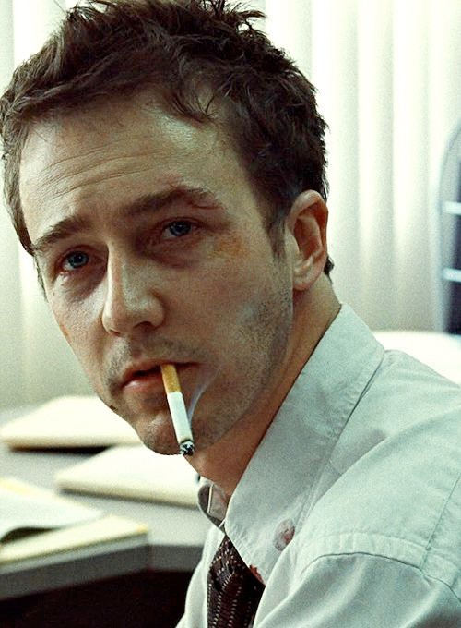

Slide 16
Discussion
storyteller
What makes a good story?
point
audience

Slide 17
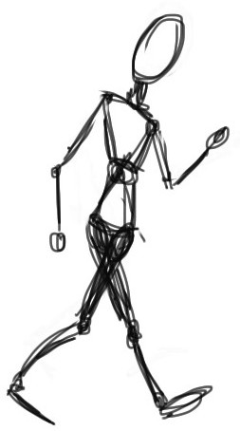


Slide 18
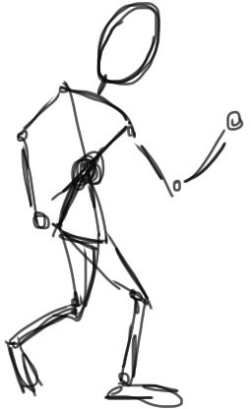

Slide 19
What is that story about?

Slide 20


What is that story about?
point

Slide 21
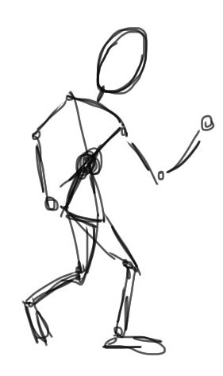

What is that story about?
point

Slide 22



Ways to get to the point
Climax of Act 2
Midpoint (plot twist!)
Crisis
Disaster
Climax of Act 3
Obstacle
Climax of Act 1
Obstacle
Obstacle
DESCENDING ACTION
Second Thoughts
ASCENDING ACTION
Inciting Incident
Wrap-up
Beginning
End
Act 1 (set up)
Act 2 (confrontation)
Act 3 (resolution)
Three Act Structure

Slide 23
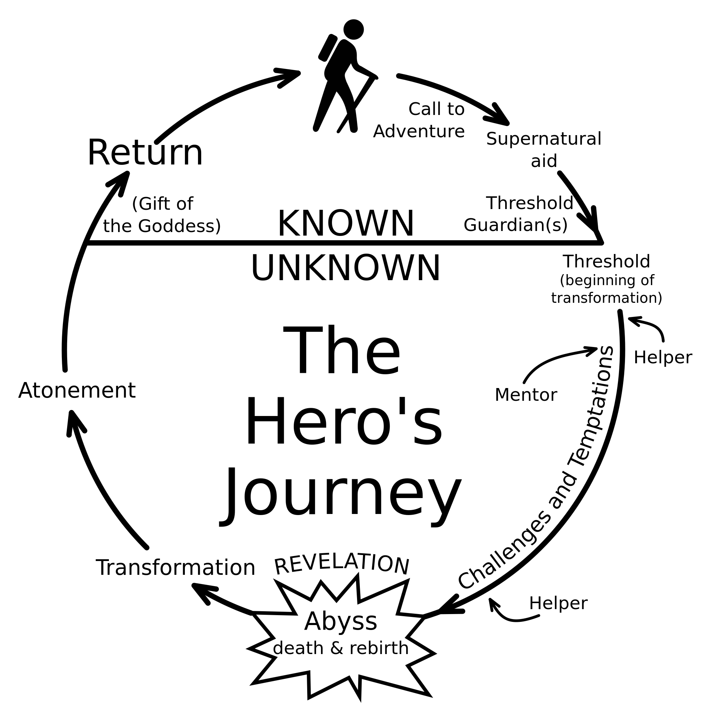
Ways to get to the point

Slide 24
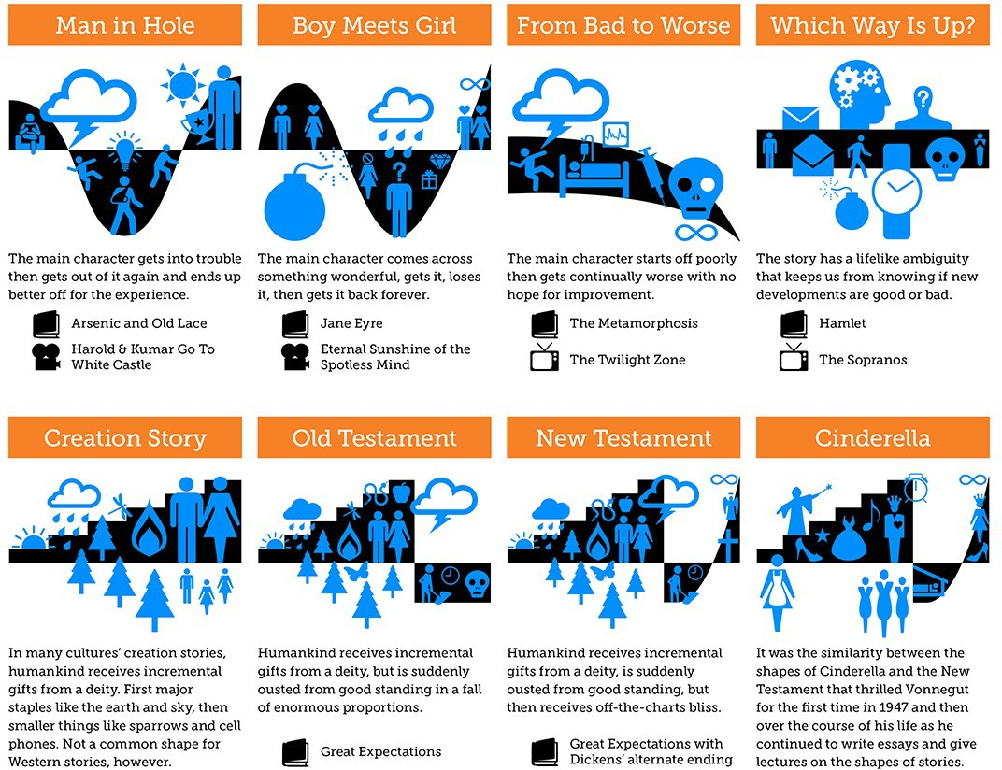
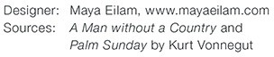
Ways to get to the point according to Vonnegut

Slide 25
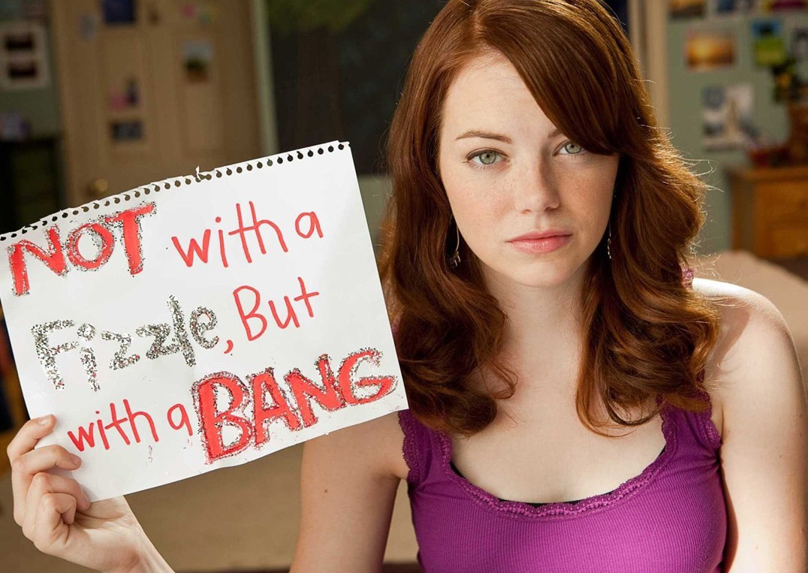
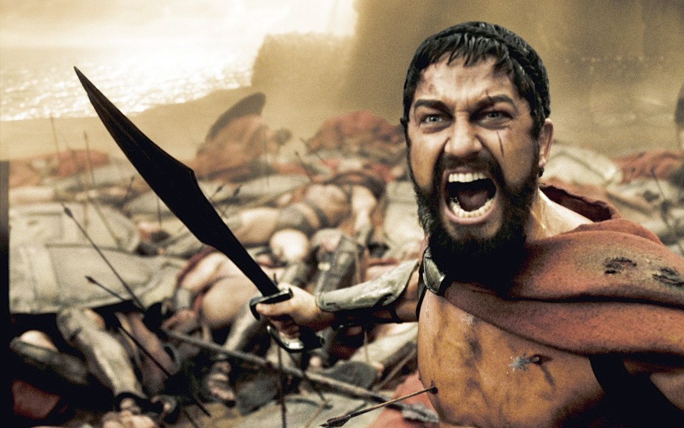
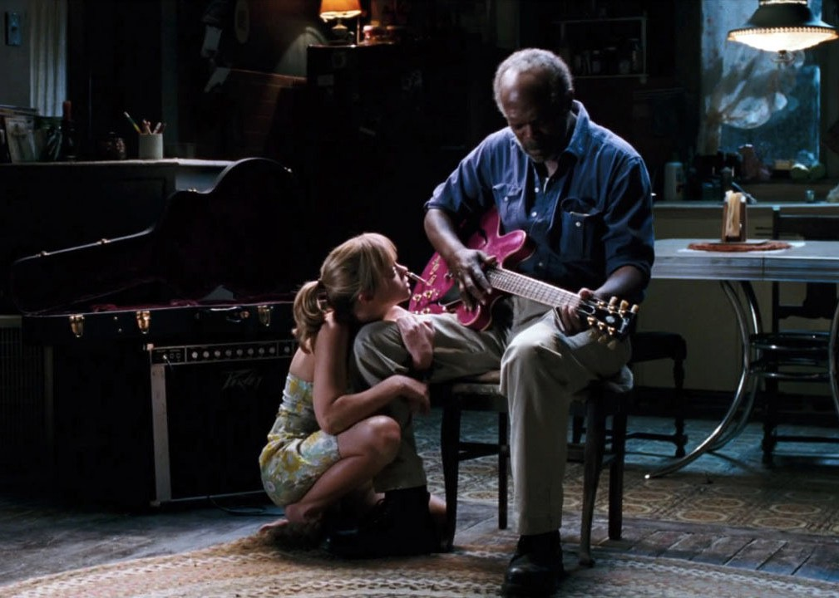


Slide 26




Slide 27
And a bunch of other stuff, too…
Touches people Characters change through experience
storyteller
Has substance
Makes people laugh
Representative of the human condition
Embraces idiosyncrasies
What makes a good story?
Relatable
point
Have something non-trivial at stake
audience
Must arrive somewhere
Makes people cry
Imaginable setting
Plot structure
Inner struggle Goes beyond the five senses
Has good characters
Outer struggle
Honest
Creates vivid images
Doesn’t default to an easy solution

Slide 28
Storytelling with visualization

Slide 29

Discussion
What makes a good data story?

Slide 30

Revisit: Napoleon’s March
“Figurative Map of the successive losses in men of the French Army in the Russian campaign 1812-1813.” Drawn by Mr. Charles Minard, Inspector General of Bridges and Roads in retirement. Paris, 20 November 1869.

Slide 31
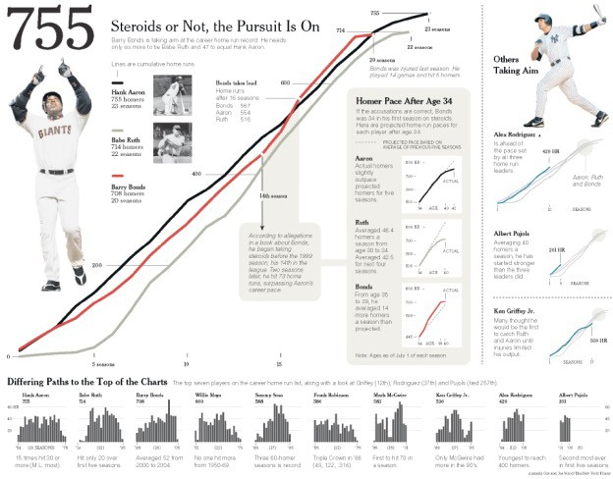
Baseball

Slide 32

Wealth inequality in the US (animated)

Slide 33

Wealth inequality in the US (interactive)

Slide 34

Learning to tell good stories
One way…

Slide 35
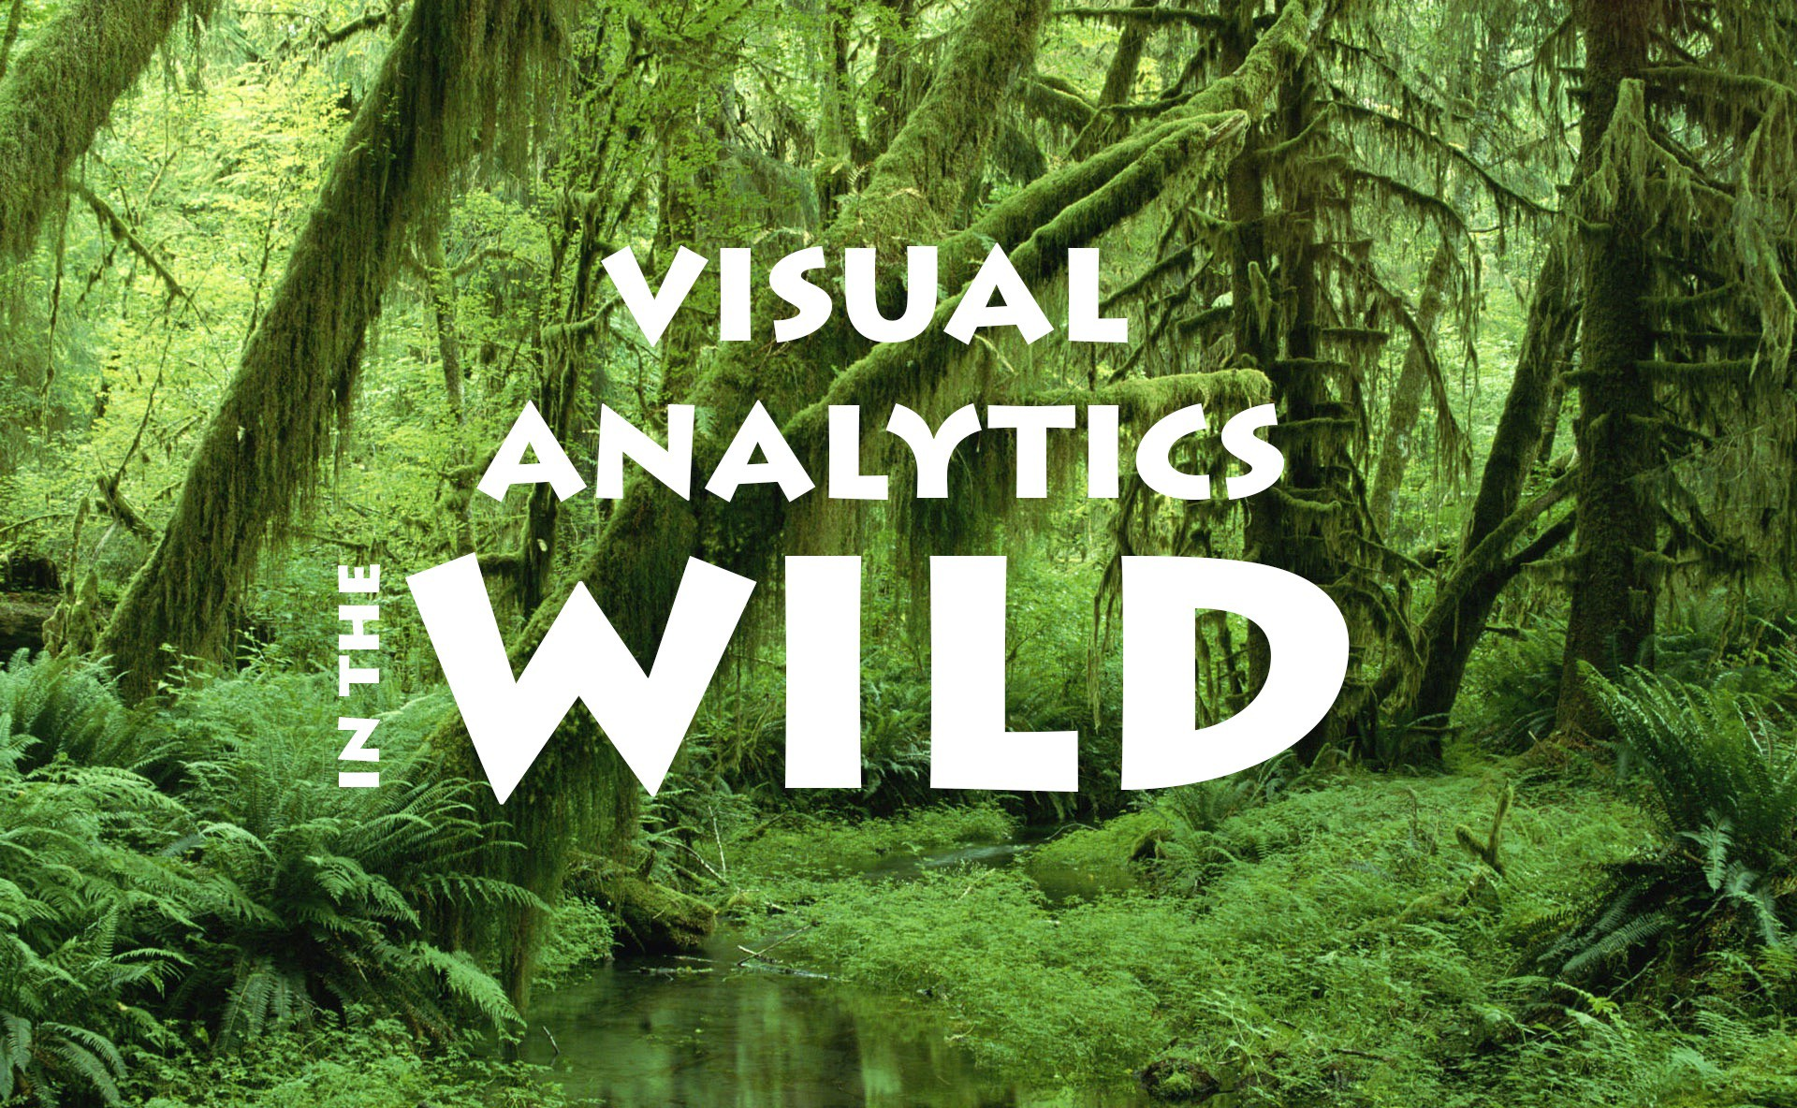
Extra credit opportunity (+3pts on overall grade)

Slide 36
VAitW presentations
Work solo or in self-selected teams of 2-3 people
Choose an interesting-to-you visual analytics system Some places to look are:
IEEE Visual Analytics Science and Technology (VAST) Conference
IEEE Symposium on Visualization for Cyber Security
VAST Challenge
Prepare a ~5 minute presentation of the highlights

Slide 37

VISUAL ANALYTICS SYSTEMS IN THE WILD
< TITLE OF PAPER >
< AUTHORS>
< PUBLICATION INFO (date, conference/journal, etc.) >
Presented by: < YOUR NAME > CSC/SDS235: Visual Analytics – Spring 2021

Slide 38
The problem
You’ll likely want to start by introducing the problem the paper is trying to solve, and any background info we need to know
If there’s a particular use case for the system, or a particular persona the authors are designing for, this is a good time to talk about that too

Slide 39
New idea
What’s the new idea the authors describe in their paper?
How does it compare with the “state of the art”? (at the time or writing, now, or both!)

Slide 40
Describe the system
How does the system work? What does it look like?
If the paper includes a demo video, you’re welcome to sample it

Slide 41
Your evaluation
What do you think of the solution the authors propose?
Did anything strike you as particularly clever?
Are there any major flaws in the approach?

Slide 42
Why you picked this paper
What drew you to this paper?
You don’t have to make a slide for this, but I’ll probably ask you about it because I’m curious ©

Slide 43
Main takeaway
What is the ultimate contribution this paper makes?
Did it solve the problem it set out to solve?

Slide 44
Coming up
Thursday: FP dataset brainstorming / topic workshop
Objective: curate >100 potential datasets
You don’t need to have a team just yet
Due next Tuesday: Critical Reflection #2 (~2 pages)
Focus: your experiences with the DCs
Many options: new skills you learned, navigating team dynamics, biggest challenges, letter to your future self, etc.
See Moodle for details

